Slide 1

COMP30680 Web Application Development Practical 7 – part b. Setting up the database for assignment 3. David Coyle d.coyle@ucd.ie

Slide 2
The database
We are going to use a sample database the contains information about a wholesale company that sells miniature models for classic cars, planes etc.
The database file is available on Moodle as a zip file.
Download and then unzip this file.
That should leave you with a file call “mysqlsampledatabase.sql”.
You can import to the MySQL database server on your localhost.
You can import the file using the PHPMyAdmin interface that is included with XAMP.
XAMPP includes MariaDB, a community-developed fork of the MySQL relational database management system intended to remain free under the GNU GPL.

Slide 3
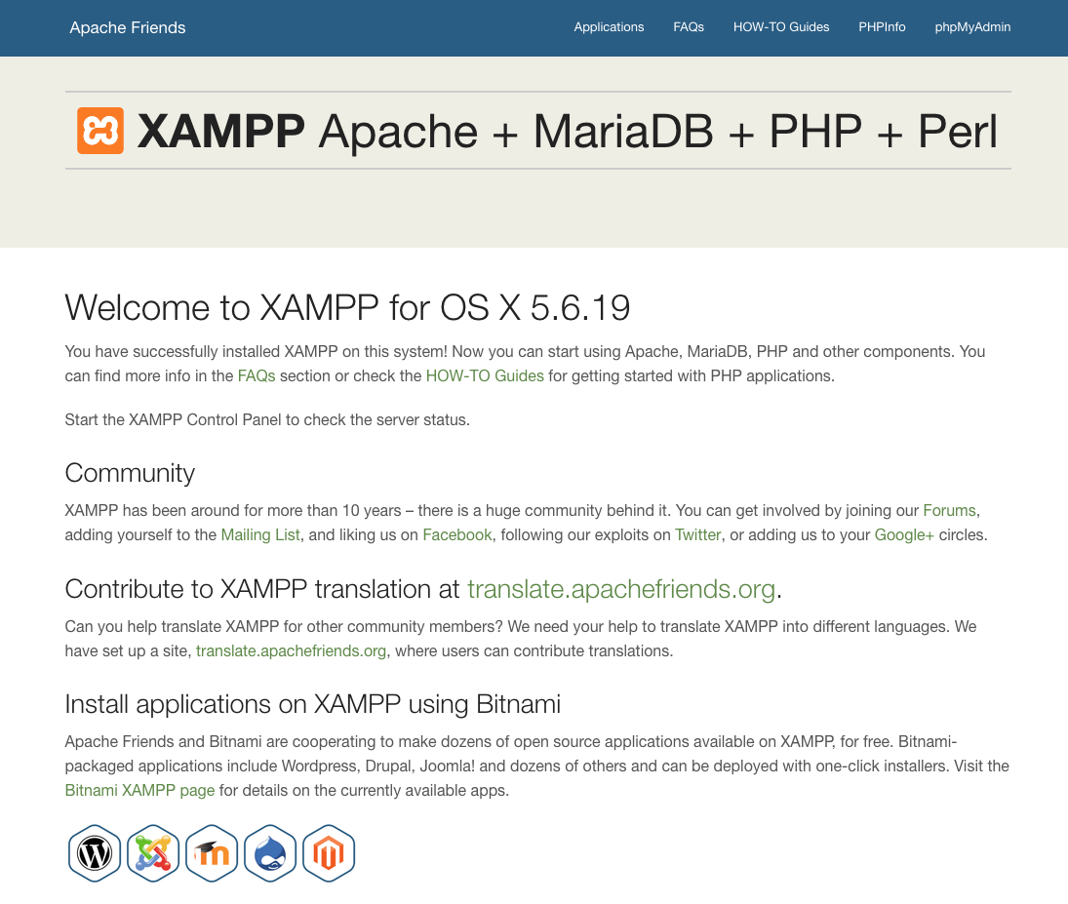
XAMPP includes
a database admin
Tool called
phpMyAdmin

Slide 4
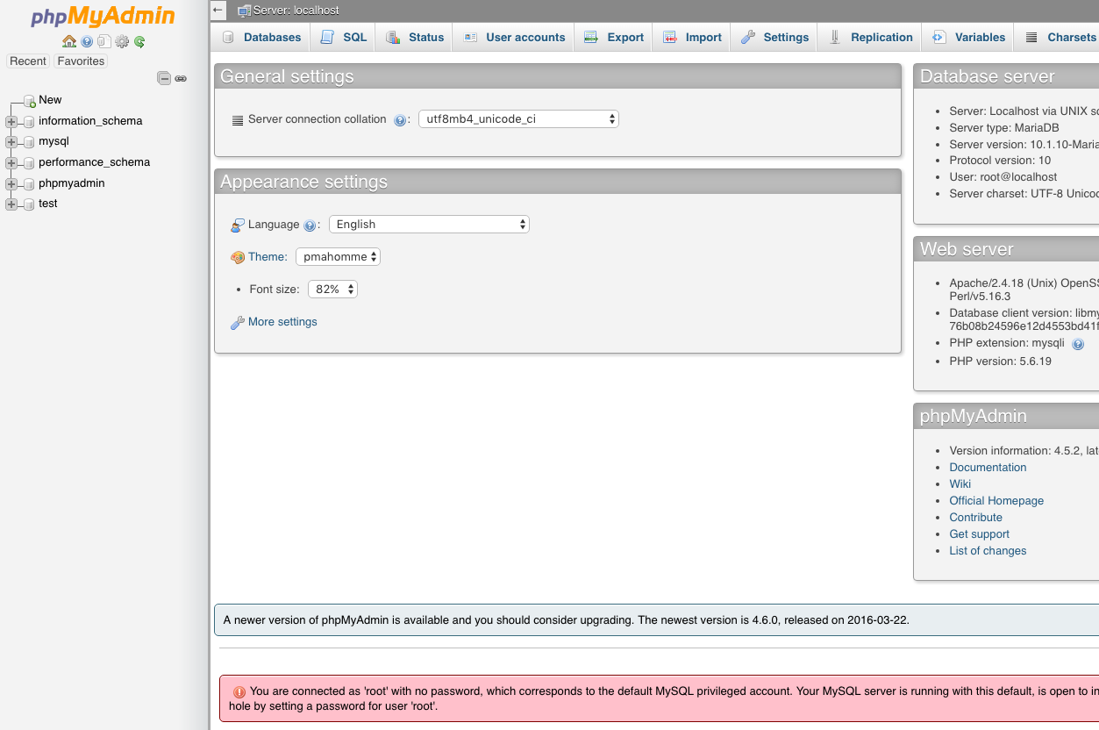

Slide 5
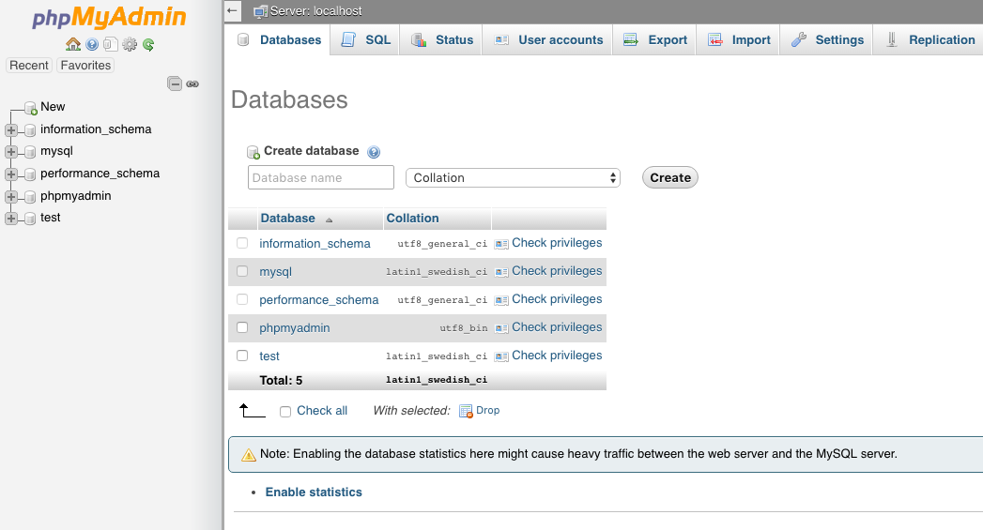
Click the Databases tab to see a list of databases on your localhost.

Slide 6
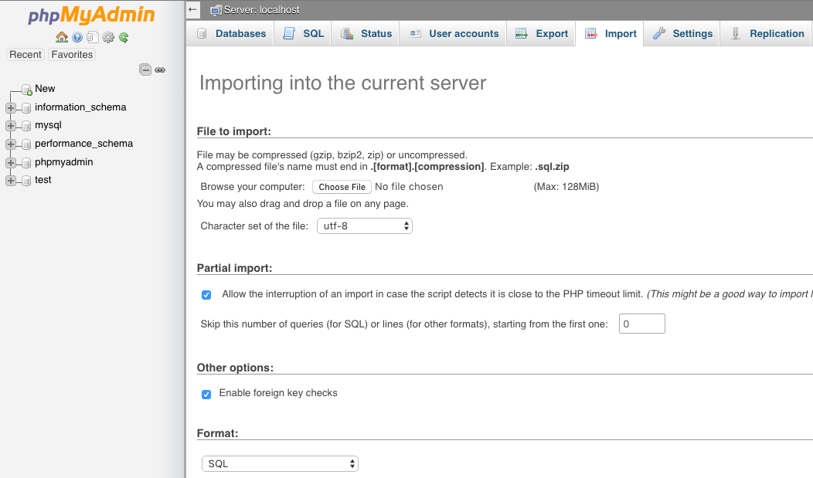
The import tab includes functionality to import databases.
This approach is ok for small databases. For large databases it is better to use Shell commands. They are more reliable.

Slide 7
The following slides show how to import the database using Terminal on a MAC or the Command Line on Windows.
This should only be necessary if the direct import using PHPMyAdmin does not work.

Slide 8
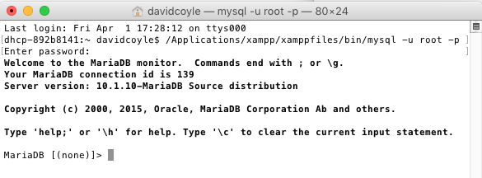
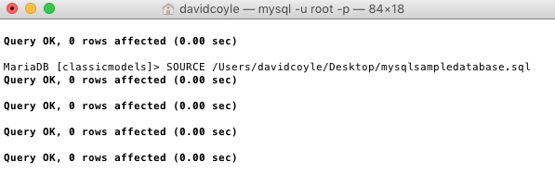
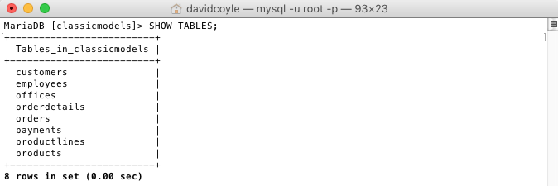
Import the database using Terminal on a MAC
Step 1: connect to the database.
If you have installed XAMPP in the standard location the following command should work:
/Applications/xampp/xamppfiles/bin/mysql -u root –p
This assumes you have not changed the default XAMPP username and password for MySQL.
Step 2: UNZIP the database archive that is available on Moodle and import the sql file using the SOURCE command.
SOURCE /Users/davidcoyle/Desktop/mysqlsampledatabase.sql
You will need to give the full path for the file on your computer. The command will not work if you have spacing in the path for the file.
Step3: run the command SHOW TABLES to make sure the database was imported.

Slide 9
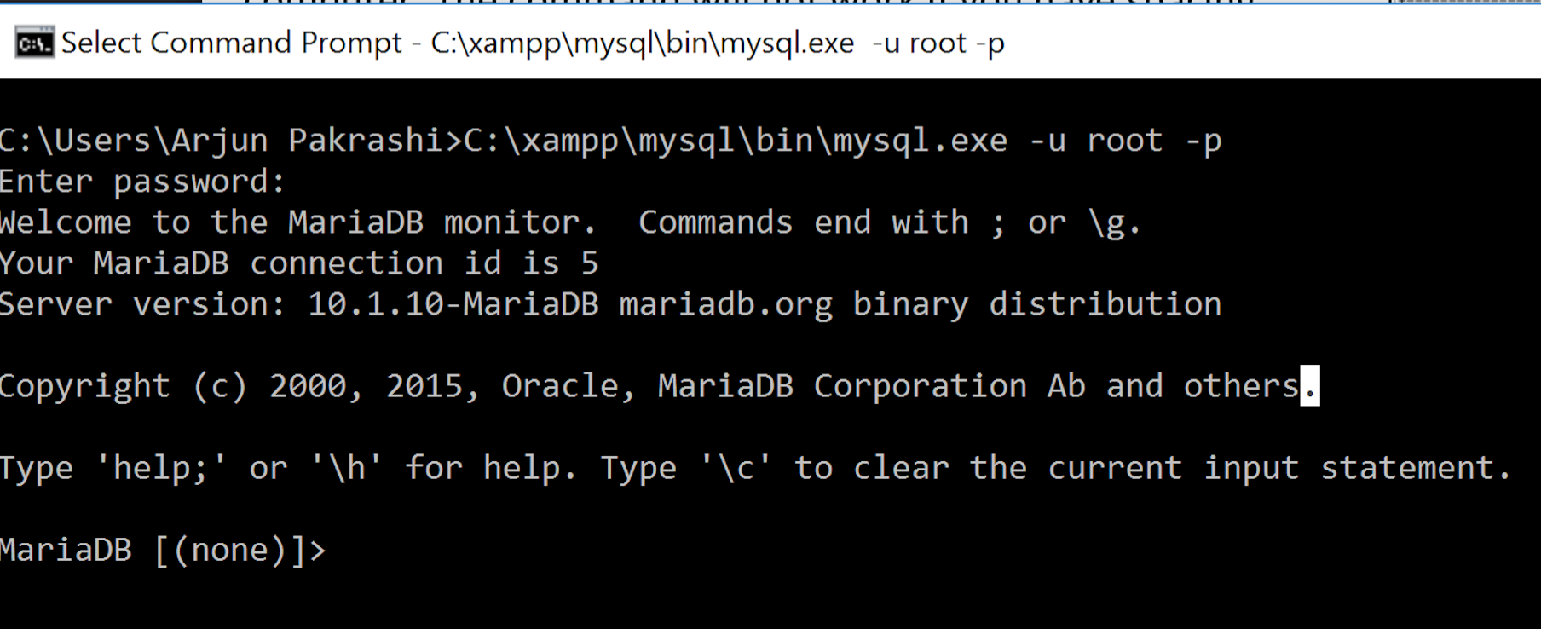
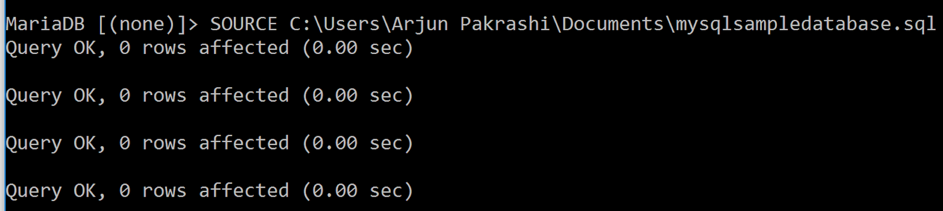
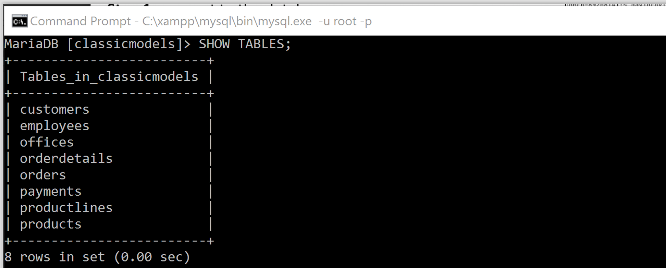
Import the database using Command Line on Windows
Step 1: connect to the database.
If you have installed XAMPP in the standard location the following command should work:
C:\xampp\xamppfiles\bin\mysql.exe -u root –p
This assumes you have not changed the default XAMPP username and password for MySQL.
Step 2: UNZIP the database archive that is available on Moodle and import the sql file using the SOURCE command.
SOURCE C:\...\mysqlsampledatabase.sql
You will need to give the full path for the file on your computer. The command will not work if you have spacing in the path for the file.
Step3: run the command SHOW TABLES to make sure the database was imported.

Slide 10
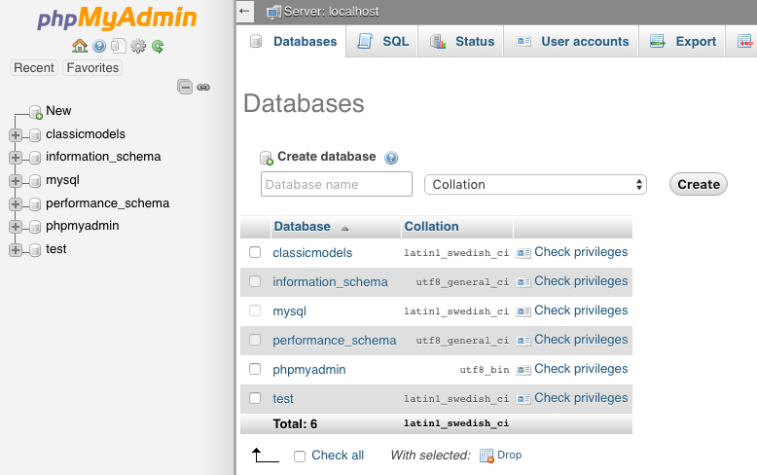
You can also check in phpMyAdmin to make sure the database was imported.

Slide 11
Database Schema
The classicmodels database schema consists of the following tables:
Customers: stores customer’s data.
Products: stores a list of scale model cars.
ProductLines: stores a list of product line categories.
Orders: stores sales orders placed by customers.
OrderDetails: stores sales order line items for each sales order.
Payments: stores payments made by customers based on their accounts.
Employees: stores all employee information as well as the organization structure such as who reports to whom.
Offices: stores sales office data.

Slide 12
Database schema

